Slide 1
Invitations
God
Calling Yet …

Slide 2
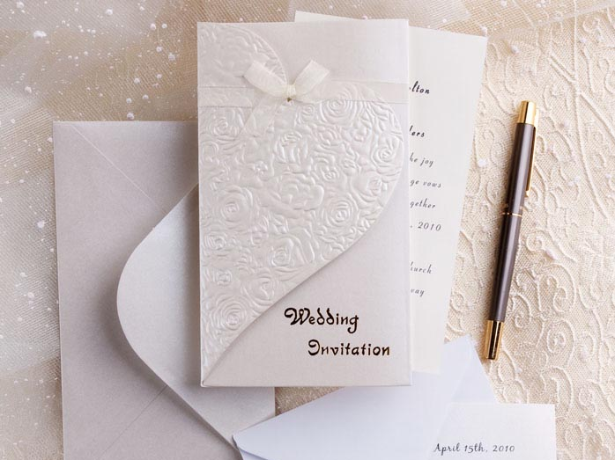

Slide 3
Invitations
John 1:38-39, “And Jesus turned, and beheld them following, and saith unto them, What seek ye? And they said unto him, Rabbi (which is to say, being interpreted, Teacher), where abideth thou? He saith unto them, Come, and ye shall see. They came therefore and saw where he abode; and they abode with him that day …”
Luke 19:5, “And when Jesus came to the place, he looked up, and said unto him, Zacchaeus, make haste, and come down; for today I must abide at thy house.”
God
Calling Yet …
Matthew 22:4, “Again he sent forth other servants, saying, Tell them that are bidden, Behold, I have made ready my dinner; my oxen and my fatlings are killed, and all things are ready: come to the marriage feast.”
Mark 1:16-17, “And passing along by the sea of Galilee, he saw Simon and Andrew the brother of Simon casting a net in the sea; for they were fishers. And Jesus said unto them, Come ye after me, and I will make you to become fishers of men.”
John 7:37, “Now on the last day, the great (day) of the feast, Jesus stood and cried, saying, If any man thirst, let him come unto me and drink.”

Slide 4
Invitations
“I will Give”
Luke 7:40-48
Luke 14:15-24
Luke 15:11-24
Ephesians 2:8-10
Revelation 3:20
God
Calling Yet …
Matthew 11:28-30, “Come unto me, all ye that labor and are heavy laden, and I will give you rest. Take my yoke upon you, and learn of me; for I am meek and lowly in heart: and ye shall find rest unto your souls. For my yoke is easy, and my burden is light.”

